Slide 1

The History of ARM and Microcontrollers Chapter 1
ARM Assembly Language Programming & Architecture

Slide 2
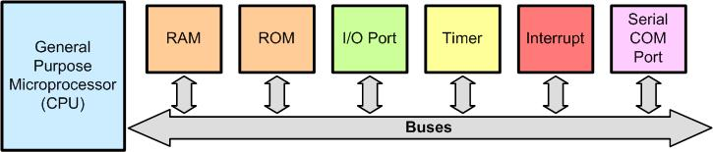
Microprocessors and Microcontrollers
A Computer Made by General Purpose Microprocessor
The microprocessors do not contain RAM, ROM, or I/O peripherals. As a result, they must be connected externally to RAM, ROM and I/O through buses

Slide 3
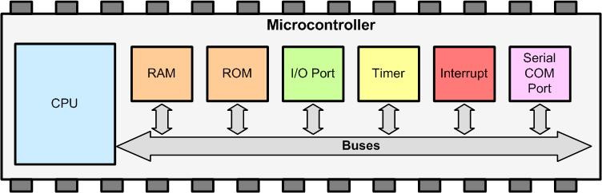
Simplified View of the Internal Parts of Microcontrollers (SOC)
In microcontroller, CPU, RAM, ROM, and I/Os, are put together on a single IC chip and it is called microcontroller. SOC (System on Chip) and MCU (Micro Controller Unit) are other names used to refer to microcontrollers.

Slide 4
ARM has defined the details of architecture, registers, instruction set, memory map, and timing of the ARM CPU and holds the copyright to it. The various design houses and semiconductor manufacturers license the IP (intellectual property) for the CPU and can add their own peripherals as they please. It is up to the licensee (design houses and semiconductor manufactures) to define the details of peripherals such as I/O ports, serial port UART, timer, ADC, SPI, DAC, I2C, and so on. As a result while the CPU instructions and architecture are same across all the ARM chips made by different vendors, their peripherals are not compatible.

Slide 5
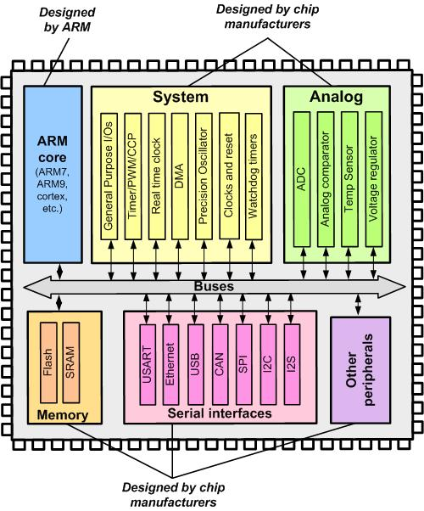
ARM Simplified Block Diagram

Slide 6
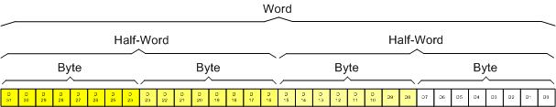
ARM Architecture
ARM Registers Data Size
ARM supports byte, half word (16 bit) and word (32 bit) data types.

Slide 7
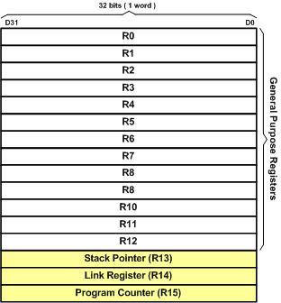
The General Purpose Registers
ARM Registers

Slide 8
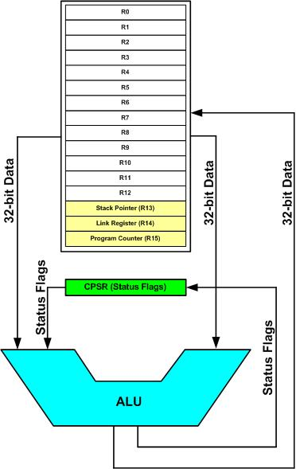
The Special Function Registers in ARM
ARM Registers and ALU

Slide 9
In ARM the R13, R14, R15, and CPSR (current program status register) registers are called SFRs (special function registers) since each one is dedicated to a specific function. A given special function register is dedicated to specific function such as status register, program counter, stack pointer, and so on. The function of each SFR is fixed by the CPU designer at the time of design because it is used for control of the microcontroller or keeping track of specific CPU status.
The R13 is set aside for stack pointer. The R14 is designated as link register which holds the return address when the CPU calls a subroutine
and the R15 is the program counter (PC). The PC (program counter) points to the address of the next instruction to be executed. The CPSR (current program status register) is used for keeping condition flags among other things. In contrast to SFRs, the GPRs (R0-R12) do not have any specific function and are used for storing general data.

Slide 10
Memory space allocation in the ARM
The ARM has 4G bytes of directly accessible memory space. This memory space has addresses 0 to 0xFFFFFFFF. The 4G bytes of memory space can be divided into five sections. They are as follows:
On-chip peripheral and I/O registers: This area is dedicated to general purpose I/O (GPIO) and special function registers (SFRs) of peripherals such as timers, serial communication, ADC, and so on. In other words, ARM uses memory-mapped I/O.
On-chip data SRAM: A RAM space ranging from a few kilobytes to several hundred kilobytes is set aside mainly for data storage. The data RAM space is used for data variables and stack and is accessed by the microcontroller instructions.
On-chip EEPROM: A block of memory from 1K bytes to several thousand bytes is set aside for EEPROM memory.

Slide 11
4. On-chip Flash ROM: A block of memory from a few kilobytes to several hundred kilobytes is set aside for program space. The program space is used for the program code.
5. Off-chip DRAM space: A DRAM memory ranging from few megabytes to several hundred mega bytes can be implemented for external memory connection.

Slide 12
A given ARM chip has the following address assignments. Calculate the space and the
amount of memory given to each section.
(a) Address range of 0x00100000 – 0x00100FFF for EEPROM
(b) Address range of 0x40000000 – 0x40007FFF for SRAM
(c) Address range of 0x00000000 – 0x0007FFFF for Flash
(d) Address range of 0xFFFC0000 – 0xFFFFFFFF for peripherals
Solution:
(a) With address space of 0x00100000 to 00100FFF, we have 00100FFF – 00100000 =
0FFF bytes. Converting 0FFF to decimal, we get 4,095 + 1, which is equal to 4K bytes.
(b) With address space of 0x40000000 to 0x40007FFF, we have 40007FFF – 40000000 =
7FFF bytes. Converting 7FFF to decimal, we get 32,767 + 1, which is equal to 32K bytes.
(c) With address space of 0000 to 7FFFF, we have 7FFFF – 0 = 7FFFF bytes. Converting
7FFFF to decimal, we get 524,287 + 1, which is equal to 512K bytes.
(d) With address space of FFFC0000 to FFFFFFFF, we have FFFFFFFF–FFFC0000 =
3FFFF bytes. Converting 3FFFF to decimal, we get 262,143 + 1, which is equal to 256K
bytes.

Slide 14
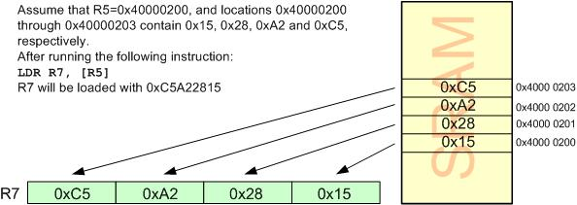
Load and Store Instructions in ARM
Every instruction of ARM is fixed at 32-bit. The fixed size instruction is one of the most important characteristics of RISC architecture.
LDR Rd, [Rx] instruction
;load Rd with the contents of location pointed to by Rx register.
Executing the LDR Instruction

Slide 15
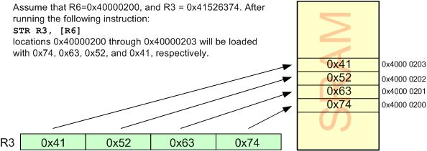
STR Rx,[Rd] instruction
;store register Rx into locations pointed to by Rd
Executing the STR Instruction

Slide 16
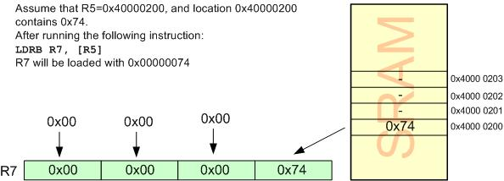
LDRB Rd, [Rx] instruction
;load Rd with the contents of the location pointed to by Rx register. After this instruction is executed, the lower byte of Rd will have the same value as memory location pointed to by Rx. The upper 24 bits of the Rd register will be all zeros
executing the LDRB Instruction

Slide 17
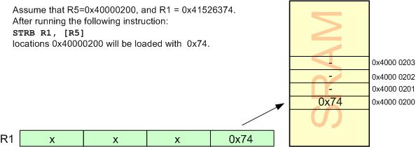
STRB Rx,[Rd] instruction
;store the byte in register Rx into location pointed to by Rd
Executing the STRB Instruction

Slide 18
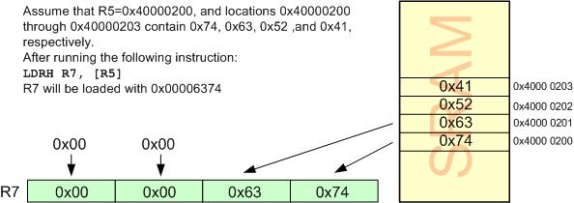
LDRH Rd, [Rx] instruction
;load Rd with the half-word (16-bit or 2 bytes) pointed to by Rx register
Executing the LDRH Instruction

Slide 19
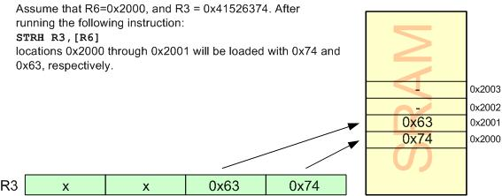
STRH Rx,[Rd] instruction
;store half-word (2-byte) in register Rx into locations pointed to by Rd
Executing the STRH Instruction

Slide 20
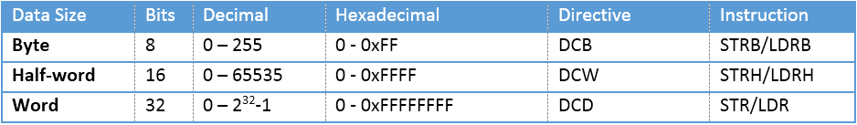
Little endian vs. big endian
In the big endian method, the high byte goes to the low address, whereas in the little endian method, the high byte goes to the high address and the low byte to the low address.
Unsigned Data Range in ARM and associated Instructions

Slide 21
ARM CPSR (Current Program Status Register)
CPSR (Current Program Status Register)
S suffix and the status register
Most of ARM instructions can affect the status bits of CPSR according to the result. If we need an instruction to update the value of status bits in CPSR, we have to put S suffix at the end of instructions. That means, for example, ADDS instead of ADD is used.

Slide 22
C, the carry flag
This flag is set whenever there is a carry out from the D31 bit. This flag bit is affected after a 32-bit addition or subtraction.
Z, the zero flag
The zero flag reflects the result of an arithmetic or logic operation. If the result is
zero, then Z = 1. Therefore, Z = 0 if the result is not zero.
N, the negative flag
The negative flag reflects the result of an arithmetic operation. If the D31 bit of the result is zero, then N = 0 and the result is positive. If the D31 bit is one, then N = 1 and the result is negative. The negative and V flag bits are used for the signed number arithmetic operations
V, the overflow flag
This flag is set whenever the result of a signed number operation is too large, causing the high-order bit to overflow into the sign bit. In general, the carry flag is used to detect errors in unsigned arithmetic operations while the overflow flag is used to detect errors in signed arithmetic operations.
The T flag bit is used to indicate the ARM is in Thumb state. The I and F flags are used to enable or disable the interrupt.

Slide 23
ARM Data Format
ARM data type
ARM has four data types. They are bit, byte (8-bit), half-word (16-bit) and word (32 bit).
Data format representation
There are several ways to represent a byte of data in the ARM assembler. The numbers can be in hex, binary, decimal, or ASCII formats.
Hex numbers
To represent Hex numbers in an ARM assembler we put 0x (or 0X) in front of the number
MOV R1,#0x99
Decimal numbers
To indicate decimal numbers in some ARM assemblers such as Keil we simply use the decimal (e.g., 12) and nothing before or after it.
MOV R7,#12

Slide 24
Binary numbers
To represent binary numbers in an ARM assembler we put 2_ in front of the number.
MOV R6,#2_10011001
Numbers in any base between 2 and 9
To indicate a number in any base n between 2 and 9 in an ARM assembler we simply use the n_ in front of it.
ASCII characters
To represent ASCII data in an ARM assembler we use single quotes as follows:
LDR R3,#‘2’ ;R3 = 00110010 or 32 in hex. ASCII of 2.
To represent a string, double quotes are used; and for defining ASCII strings (more than one character), we use the DCB directive.

Slide 25
ARM assembly language module
An ARM assembly language module has several constituent parts. These are:
Extensible Linking Format (ELF) sections (defined by the AREA directive).
Application entry (defined by the ENTRY directive).
Program end (defined by the END directive).
Assembler Directives
Assembler directives are the commands to the assembler that direct the assembly
process.
They do not generate any machine code i.e. they do not contribute to the final size
of machine code and they are assembler specific
AREA:
The AREA directive tells the assembler to define a new section of memory. The memory can be code (instructions) or data and can have attributes such as READONLY, READWRITE and so on. This is used to define one or more blocks of indivisible memory for code or data to be used by the linker. The following is the format:
AREA sectionname attribute, attribute, …

Slide 26
The following line defines a new area named mycode which has CODE and
REASDONLY attributes:
AREA mycode, CODE, READONLY
Commonly used attributes are CODE, DATA, READONLY, READWRITE
READONLY:
It is an attribute given to an area of memory which can only be read from. It is by default for CODE. This area is used to write the instructions.
READWRITE:
It is attribute given to an area of memory which can be read from and written to. It is by default for DATA.
CODE:
It is an attribute given to an area of memory used for executable machine instructions. It is by default READONLY memory.

Slide 27
DATA:
It is an attribute given to an area of memory used for data and no instructions can be placed in this area. It is by default READWRITE memory.
ALIGN:
It is used to indicate how memory should be allocated according to the addresses. When the ALIGN is used for CODE and READONLY, it is
aligned in 4-bytes address boundary by default since the ARM instructions are 32 bit word. If it is written as ALIGN = 3, it indicates that the information should be placed in memory with addresses of 2³, that is for example 0x50000, 0x50008, 0x50010, 0x50018
and so on.
EXPORT:
The EXPORT directive declares a symbol that can be used by the linker to resolve symbol references in separate object and library files.

Slide 28
DCD (Define constant word):
Allocates a word size memory and initializes the values. Allocates one or more words of memory, aligned on 4-byte boundaries and defines initial run time contents of the memory.
ENTRY:
The ENTRY directive declares an entry point to the program. It marks the first instruction to be executed. In applications using the C library, an entry point is also contained within the C library initialization code. Initialization code and exception handlers also contain entry points
END:
It indicates to the assembler the end of the source code. The END directive is the last line of the ARM assembly program and anything after the END directive in the source file is ignored by the assembler.
EQU:
Associate a symbolic name to a numeric constant.
RN (equate)
This is used to define a name for a register. The RN directive does not set aside a separate storage for the name, but associates a register with that name. It improves the
clarity.
VAL1 RN R1 ;define VAL1 as a name for R1

Slide 29
SPACE directive
Using the SPACE directive we can allocate memory for variables.
LONG_VAR SPACE 4 ;Allocate 4 bytes
OUR_ALFA SPACE 2 ;Allocate 2 bytes
Pseudo Instructions:
LDR Pseudo Instruction
LDR Rd,=32-bit_immidiate_value
Notice the = sign used in the syntax. The following pseudo-instruction loads R7 with 0x112233.
LDR R7, =0x112233
To load values less than 0xFF, “MOV Rd, #8-bit_immidiate_value” instruction is used since it is a real instruction of ARM, therefore more efficient in code size.
ADR Pseudo Instruction
To load registers with the addresses of memory locations we can also use the ADR
pseudo-instruction which has a better performance. ADR has the following syntax:
ADR Rn, label
ADR R2, OUR_FIXED_DATA ;point to OUR_FIXED_DATA

Slide 30
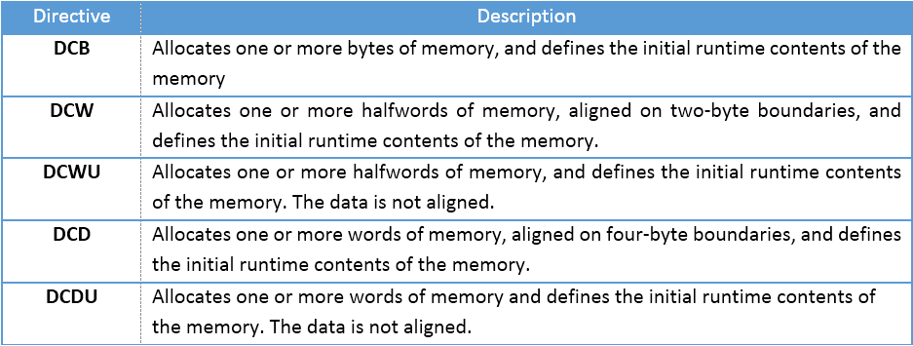
Some Widely Used ARM Memory Allocation Directives

Slide 31
An Assembly language instruction consists of four fields:
[label] mnemonic [operands] [;comment]
The first column of each line is always considered as label. Thus, be careful to press a Tab at the beginning of each line that does not have label; otherwise, your instruction is considered as a label and an error message will appear when compiling.

Slide 32
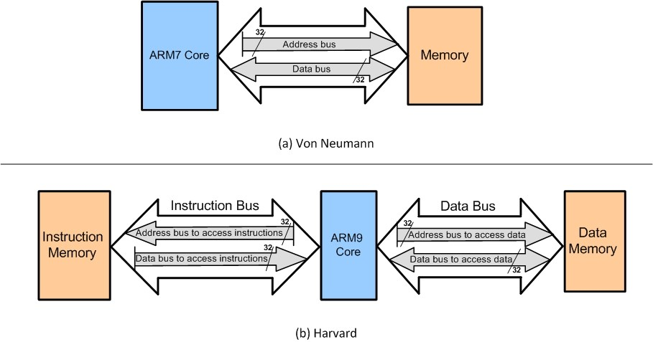
Harvard and von Neumann architectures in the ARM
In von Neumann, there are no separate buses for code and data memory. In Harvard, there are separate buses for code and data memory.

Slide 33
When the CPU wants to execute the “LDR Rd,[Rx]” instruction, it puts Rx on the address bus of the system, and receives data through the
data bus. For example, to execute “LDR R2,[R5]”, assuming that R5 = 0x40000200, the CPU puts the value of R5 on the address bus. The Memory puts the contents of location 0x40000200 on the data
bus. The CPU gets the contents of location 0x40000200 through the data bus and brings into CPU and puts it in R2.
The “STR Rx,[Rd]” instruction is executed similarly. The CPU puts Rd on the address bus and the contents of Rx on the data bus. The memory location whose address is on the address bus receives the contents of data bus.

Slide 34
Addressing modes
1. register
2. immediate
3. register indirect (indexed addressing mode)

Slide 35
Indexed addressing mode
In the indexed addressing mode, a register is used as a pointer to the data location. The ARM provides three indexed addressing modes. These modes are: preindex, preindex with write back, and post index.
Preindexed addressing mode with fixed offset:
LDR R0, [R1, #4] ;Load R0 from [R1+4]
LDR R0, [R1, #-4] ; Load R0 from [R1-4]

Slide 36
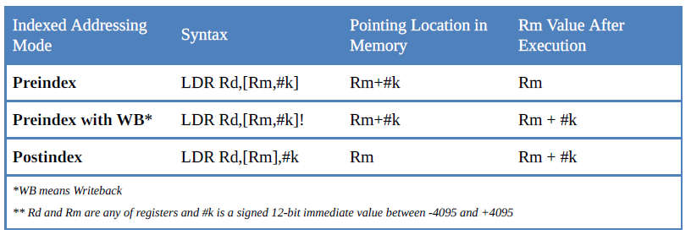
Preindexed addressing mode with write-back and fixed offset
LDR R0, [R1, #4]! ; Load R0 from [R1+4], R1 = R1 +4
Postindexed addressing mode with fixed offset
LDR R0, [R1], #4 ; Load R0 from [R1], R1 = R1 +4
Table 6-2 summarizes these addressing modes. Each of these indexed addressing mode can be used with offset of fixed value or offset of a shifted register.
Table 6-2: Indexed Addressing in ARM

Slide 37
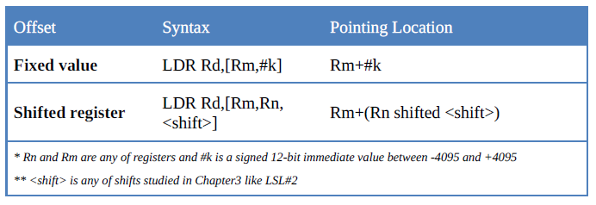
Preindexed address mode with offset register:
LDR R0, [R1, R2] ; Load R0 from [R1 + R2]
Preindexed address mode with offset of a shifted register
LDR R1,[R2,R3,LSL#2] ;content of location R2+(R3×4) (i.e; R2 + R3 LSL by 2) is loaded to R1
WB in Preindexed address mode with offset of a shifted register
LDR R1,[R2,R3,LSL#2]! ;content of location R2+(R3×4) is loaded to R1
;R2 = R2 +(R3 × 4)
Program counter relative LDR R0, [PC, #offset]
Scaled register postindex
STR R1,[R2],R3,LSL #2 ;store R1 at location R2 of memory and write back ;R2 = R2 + (R3 × 4)
Table 6-3: Offset of Fixed Value vs. Offset of Shifted Register

Slide 38
RISC Features
Fixed Instruction Size(Helps Inst. Decoder)
Large no of registers(less memory operations)
Smaller inst. Set
Single clock cycle inst. Execution
Hardwiring
Load/Store Architecture

